Slide 1

Car Price Prediction
Using Deep Learning
CSE 433 — Emerging Topics in CS & Engineering: Deep Learning
Submitted to: Assoc. Prof. Dr. Mohammed Kamal Abdel Salam
Jana Elsalhy · 120220093
Tasbih Othman · 120220117
Shiref Ashraf · 120220099
Karim Mazroua · 120220118
Ahmed Nagah · 120220116
Yasmeen Sameh · 120220143
E-JUST | May 13, 2026

Slide 2



Agenda
01
03
Business Value
Results
The problem, objectives & who benefits
Performance metrics, feature importance & error analysis
02
04
Technical Solution
Lessons Learned
Dataset, preprocessing, model & web app
Limitations, future improvements & conclusion

Slide 3
The Problem
Why is used car pricing so difficult?
Information Asymmetry
Buyers can't tell if a listed price is fair; sellers lack benchmarks to price competitively.
Used Car
Market Challenge
Too Many Variables
Vehicle pricing depends on many interconnected variables, making manual estimation difficult and inconsistent.
Age, mileage, brand, fuel type, ownership history — humans cannot process them simultaneously.
Inconsistent Methods
Incorrect pricing leads to
financial loss for both buyers & sellers
Traditional pricing relies on manual estimates, historical averages, or subjective judgment.

Slide 4




Business Value
Our solution delivers impact across the entire used-car ecosystem
Car Buyers
Sellers & Dealerships
Automotive Platforms
Instantly verify if an asking price is fair
Price vehicles competitively from day one
Integrate into online car-selling platforms
Compare against model predictions before purchase
Reduce time-on-lot with accurate listings
Power dealership inventory pricing systems
Make confident, data-backed decisions
Maximise profit with market-aligned pricing
Support insurance & financing valuation
Project Objectives: Develop an intelligent system · Analyze pricing factors · Build a complete DL pipeline · Scalable for real-world integration

Slide 5
02
Technical Solution
Dataset · Preprocessing · Model Architecture · Web App

Slide 6
Dataset & Feature Engineering
~3,000 used car records with structured numerical and categorical features
Feature
Type
Description
Feature Engineering
Brand
Categorical
Vehicle manufacturer
Derived Features
Model
Categorical
Vehicle model (target encoded)
VehicleAge = 2026 − Year
Year
Integer
Manufacturing year
KM_per_Year = KM_Driven / (VehicleAge + 1)
Engine_CC
Numerical
Engine displacement
Log transformation on Price_USD
Power_BHP
Numerical
Engine power output
Categorical Encoding
Fuel_Type
Categorical
Fuel type (one-hot)
Transmission
Categorical
Transmission type (one-hot)
One-Hot Encoding:
Brand, Fuel Type, Transmission
Owner_Type
Ordinal
Number of previous owners
Target Encoding:
Model (reduces dimensionality
while preserving price signal)
KM_Driven
Numerical
Total driven kilometers
Ordinal Encoding:
Price_USD
Numerical
Target: vehicle selling price
Owner_Type

Slide 7
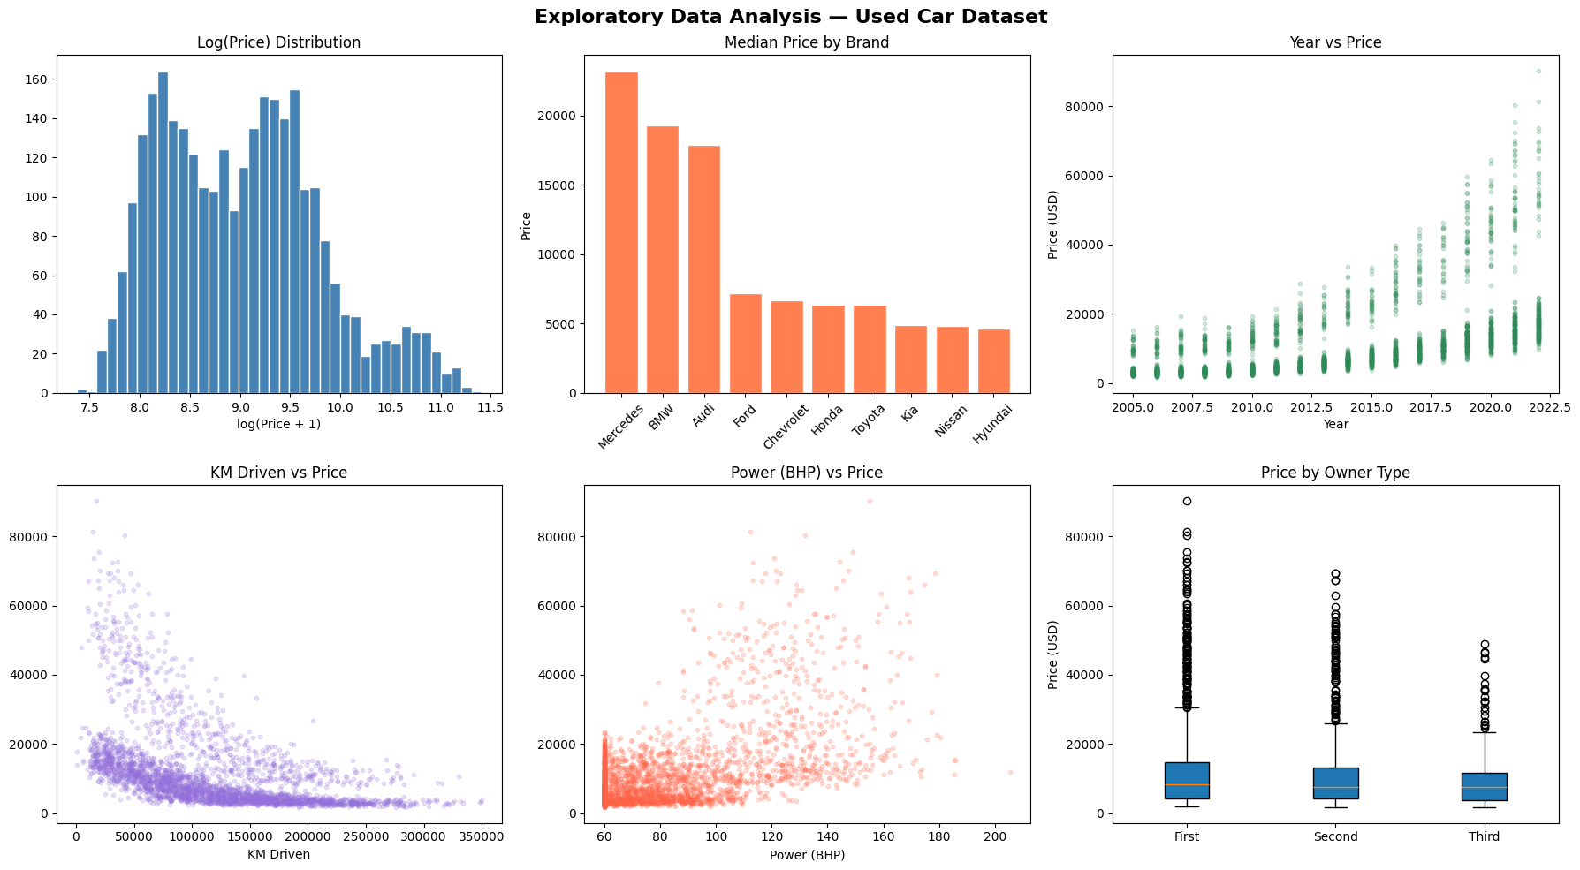
Dataset & Feature Engineering
Feature Engineering

Slide 8
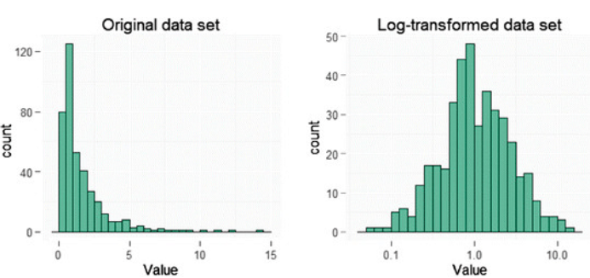
Log Transformation
Feature Engineering

Slide 9
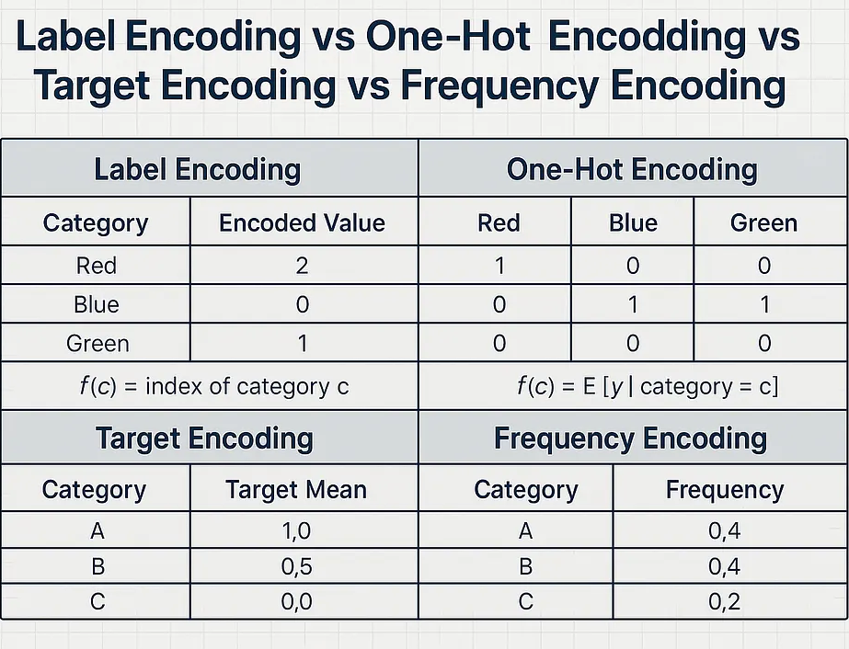
Target Encoding
Feature Engineering

Slide 10
Preprocessing Pipeline
1
1
2
3
4
5
6
Log Transformation
Feature Engineering
Outlier Clipping
Categorical Encoding
Feature Scaling
Train / Test Split
›
›
›
›
›
Apply log to Price_USD to reduce skewness
Create VehicleAge and KM_per_Year features
Clip extreme price values to valid range
One-hot + target + ordinal encoding
MinMax / Standard scaler (fit on train only)
85% train · 15% validation — fixed seed

Slide 11

Model Architecture
Fully connected feed-forward neural network built with Keras/TensorFlow
Input Layer
Training Configuration
Numerical + encoded categorical features
↓
Optimizer
Adam
Dense 128 ReLU
Dropout 15%
Learning Rate
0.001
↓
Dense 64 ReLU
Loss Function
MSE (in log space)
Dropout 10%
↓
Batch Size
16
Dense 32 ReLU
No regularization
Epochs
300
↓
Output Layer
Validation Split
15%
1 neuron — Linear activation (log-price)
Early Stopping
Patience = 10

Slide 12

Live Web Application
End-to-end Flask app connecting the trained Keras model to a browser UI
Browser UI
→
Flask Server
→
Keras Model
→
Price Output
CarPrice_Live_Demo.html
Beautiful input form
app.py
/predict API endpoint
.keras file loaded
at server start
Real-time USD
price estimation
Input form: brand, model, year, engine CC, power BHP, fuel type, transmission, owner type & mileage
Single-click 'Predict Price' → instant deep-learning inference via Flask /predict API
CLI batch inference supported: python srs/inference.py --csv path/to/new_cars.csv
Reproducibility guaranteed: fixed random seed · leakage-free preprocessing saved with model

Slide 13
03
Results
Metrics · Feature Importance · Error Analysis

Slide 14

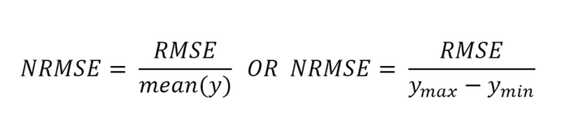
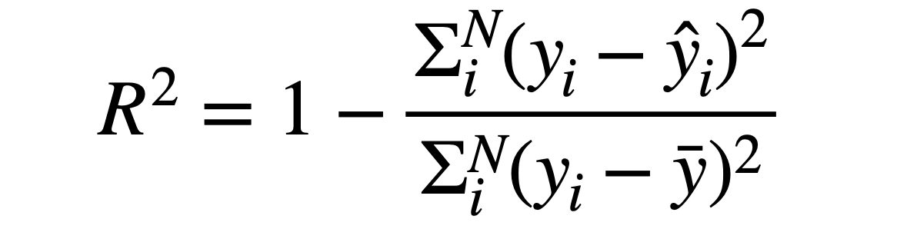
Model Performance
Evaluated on held-out test set — strong generalisation with minimal overfitting
R² Score
RMSE
MAE
MAPE
NRMSE
0.9899
$1,109.73
$651.32
5.75%
0.0157
99% of price variance explained
Root Mean Squared Error
Mean Absolute Error
Mean Absolute Percentage Error
Normalised RMSE (very low)

Slide 15
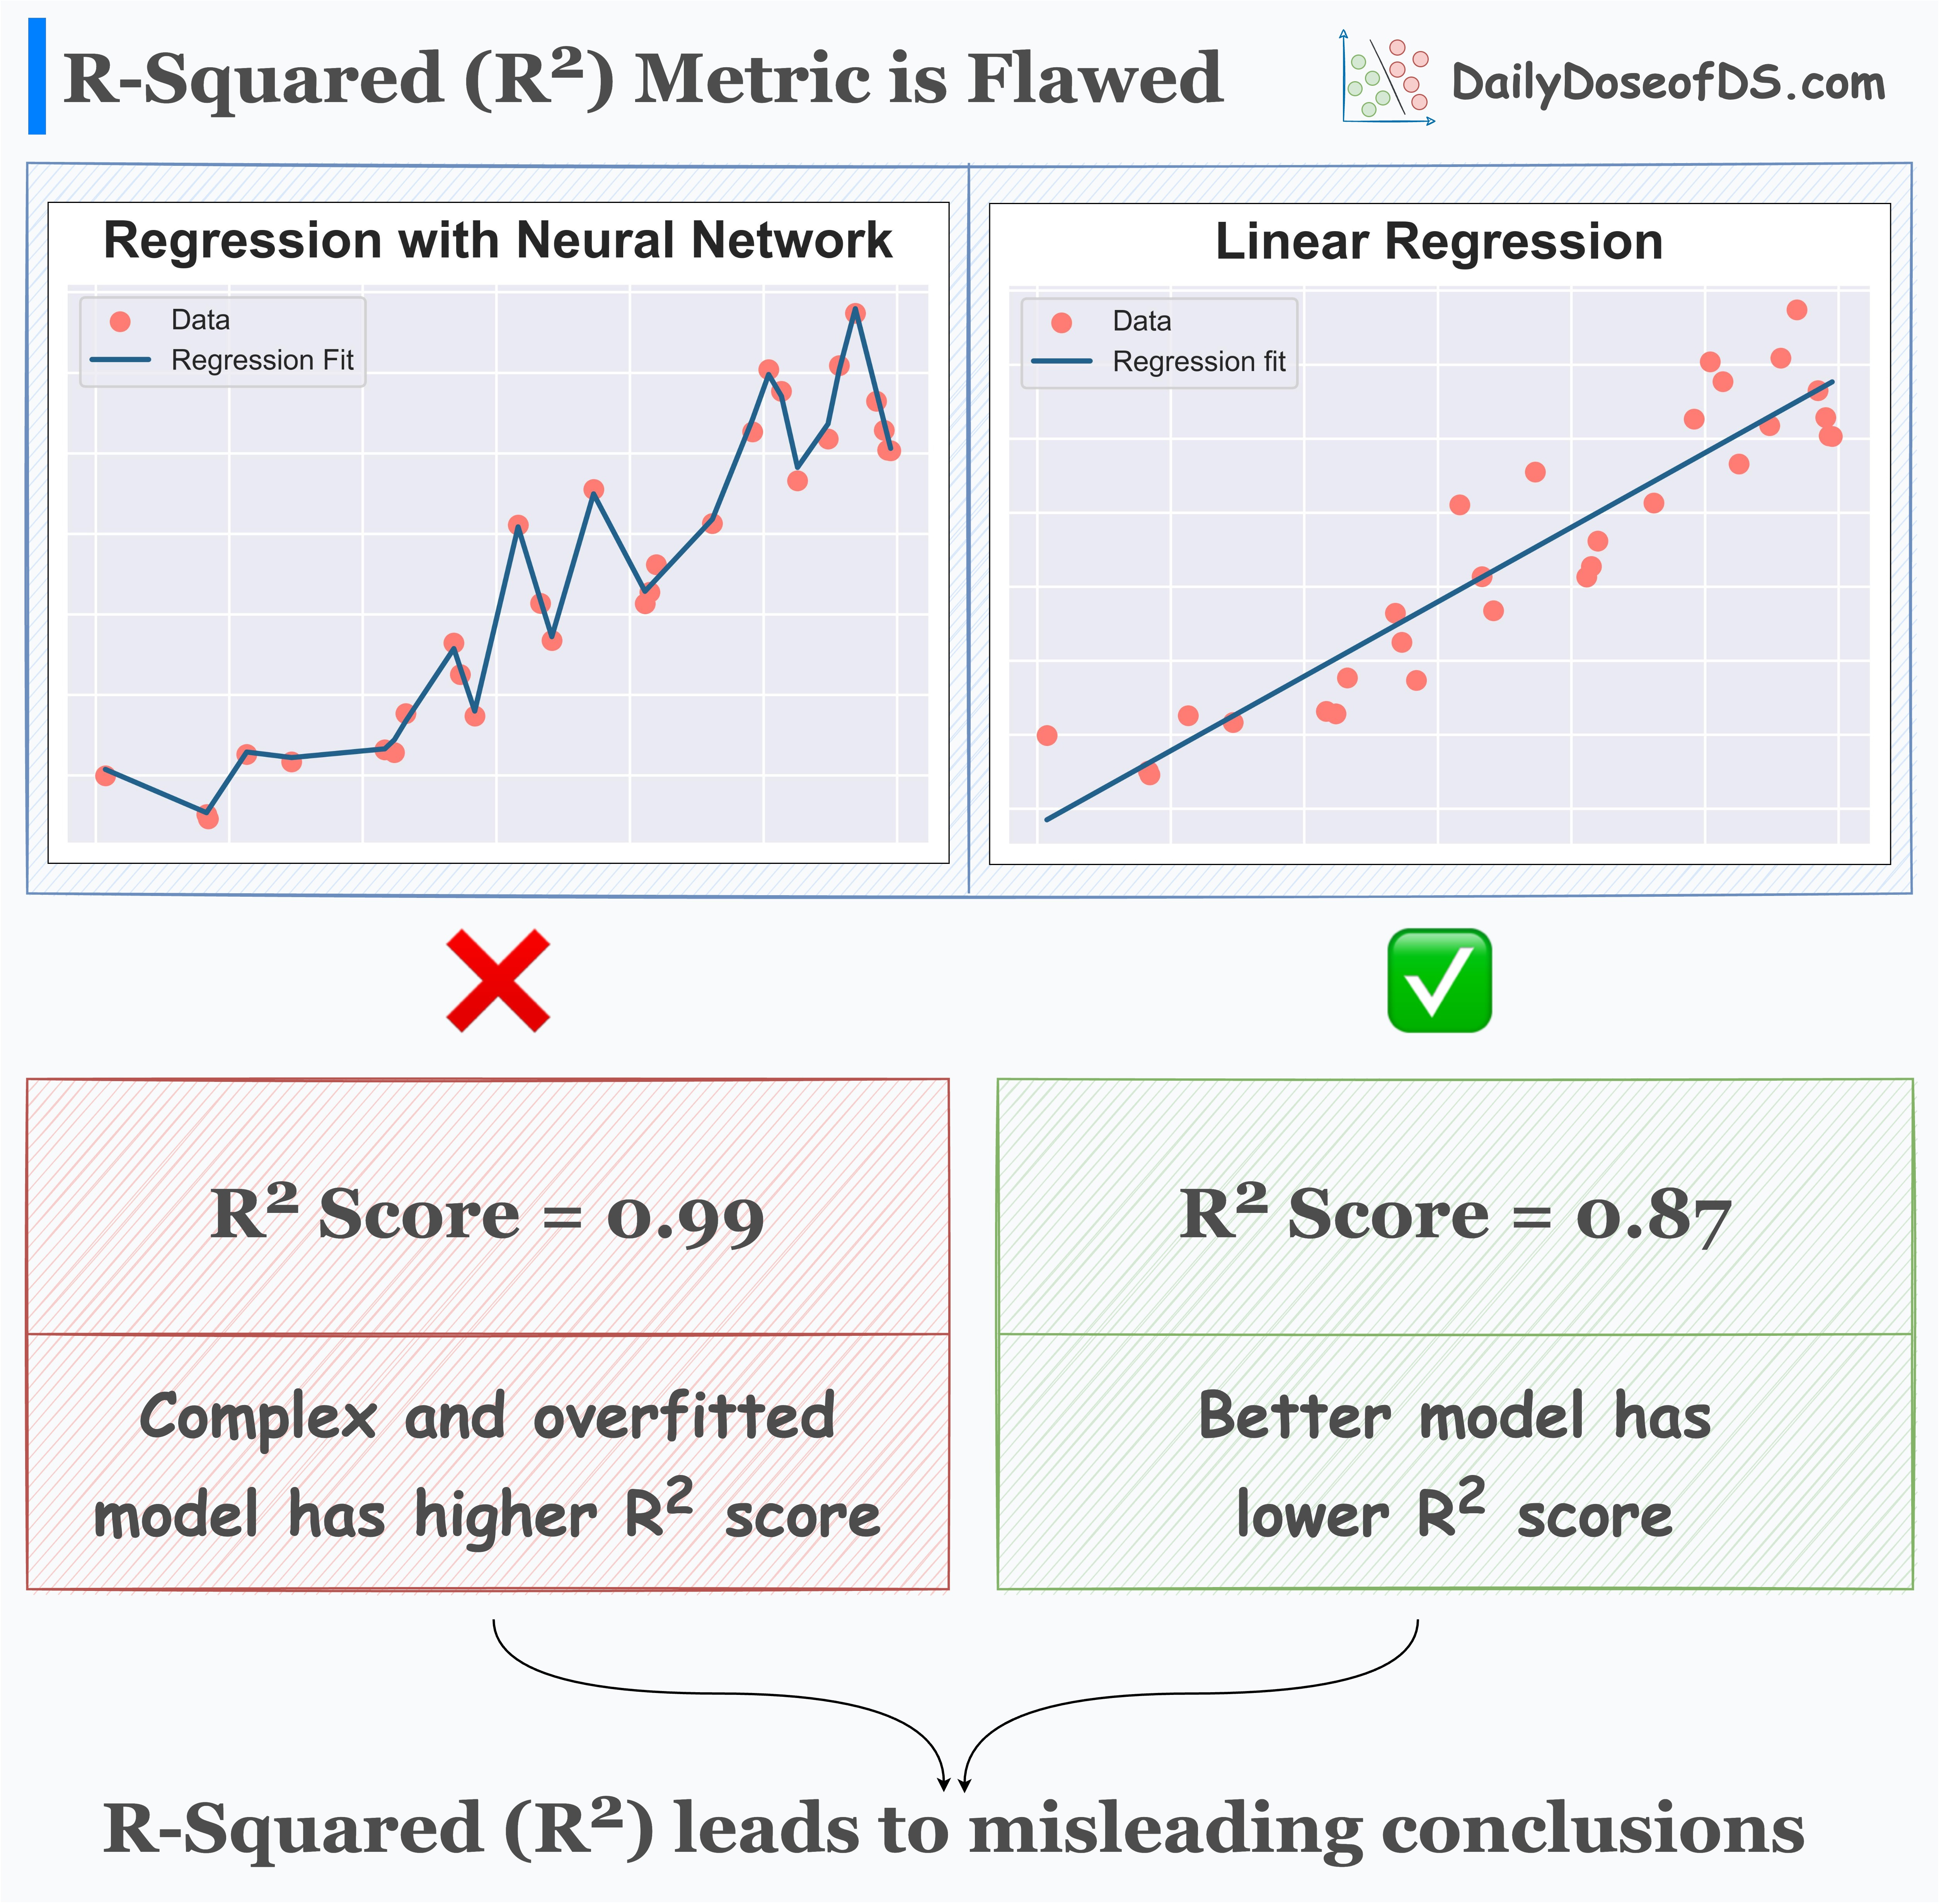
R2 Score
R² Score
RMSE
MAE
MAPE
NRMSE
0.9899
$1,109.73
$651.32
5.75%
0.0157

Slide 16
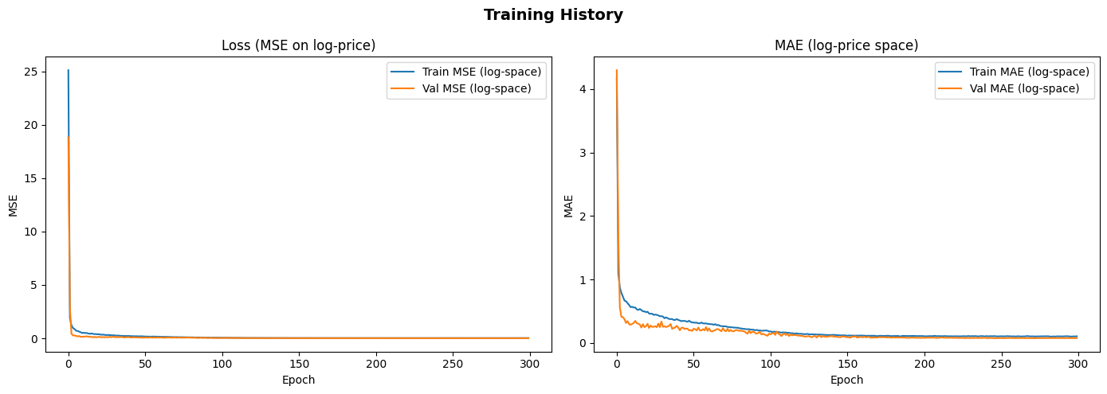
Model Performance
R² Score
0.9899

Slide 17
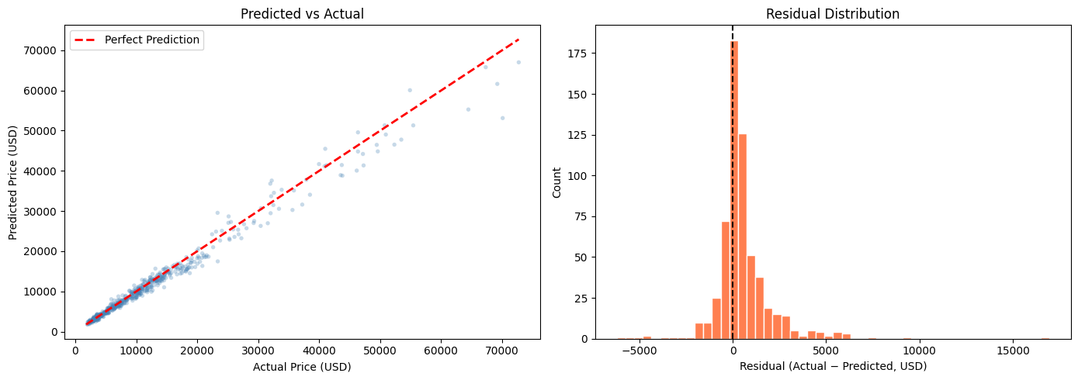
Error & Bias–Variance Analysis
On average the model predicts within 5.75% MAPE of the actual price — reliable enough for real-world pricing decisions.

Slide 18


Error & Bias–Variance Analysis
Bias–Variance
Small gap between training and test performance confirms excellent generalisation with minimal overfitting. The model is well-balanced.
Error Patterns
Slightly higher error observed for luxury vehicles. Increased variance in the high-price segment (>$50K). Limited coverage of rare models.
Residual Distribution
Residuals are approximately normally distributed and centred near zero — confirming the model captures the main pricing signal.
On average the model predicts within 5.75% MAPE of the actual price — reliable enough for real-world pricing decisions.

Slide 19

Lessons Learned
What worked, what we'd do differently, and where we go next
What Worked Well
Challenges Faced
Dropout (15%/10%) significantly reduced overfitting
Limited dataset (~3K records) constrained model capacity
Log-space MSE loss stabilised optimisation of skewed prices
High-cardinality brand/model features required careful encoding
Target encoding for Model preserved price signal without explosion
Outlier luxury prices increased variance in high-price segment

Slide 20

Thank You
Questions & Discussion
Business Value
Results
Transparent, data-driven pricing for buyers, sellers & platforms
R² = 0.9899 · MAE = $651.32 · MAPE = 5.75%
Technical Solution
Lessons Learned
4-layer DNN + Flask app + CLI inference · Keras / TensorFlow
Log-space loss + Dropout + leakage-free pipeline = robust model

